Slide 1

North Carolina Brigade
Project
Raleigh Chapter
North Carolina Society
Sons of the American Revolution
David E McCracken Presenter
dem32415@aol.com or 828.550.5980

Slide 2
Background
On 28 November 1775, The Continental Congress ordered North Carolina to provide sufficient numbers of men to help the Continental Army, to be paid by the Continental Congress and not by the state.
North Carolina raised ten (10) regiments over time. They were mostly assigned to the Southern Department.
On 8 July 1777, the regiments were re-assigned to the Northern Department as the North Carolina Brigade and ordered to move.

Slide 3
Background (cont)
The ‘new’ North Carolina Brigade departed Halifax, NC; marched north through Williamsburg and Richmond, VA; and were inoculated against smallpox in Alexandria, VA.
On 25 August 1777, as the NC Brigade through Philadelphia, PA, a Swiss artist, Pierre Eugene du Simitiere sketched their arrival.
That original sketch is now displayed in the Museum of American Revolution in Philadelphia ~ with preservation funded by a gift of the North Carolina Society of the Cincinnati.

Slide 4
NC Brigade Project
Raleigh Chapter, North Carolina Society of the Sons of the American Revolution is creating a life size exhibit of the sketch
Included in that sketch:
  Continental soldiers on foot & horseback, plus two on wagon who are suspected to have had complications from the smallpox vaccination
  A barefoot Militia soldier
  Provisions wagon with black waggoneer
  Camp follower woman, baby and nanny
Upon completion, it will be transported to National SAR Congress in Greensboro (10 to 16 July 2026) & America250NC events to highlight the contributions of North Carolina to establish the United States of America.

Slide 5
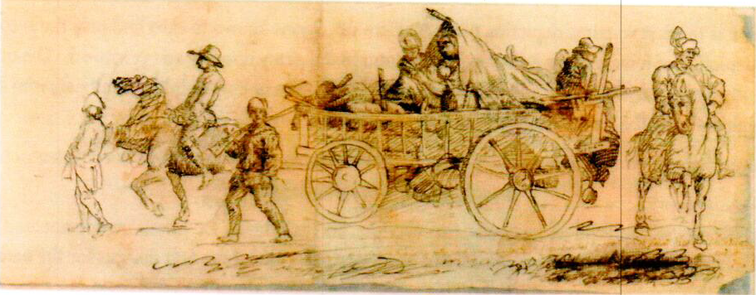
Sketch of the NC Brigade

Slide 6
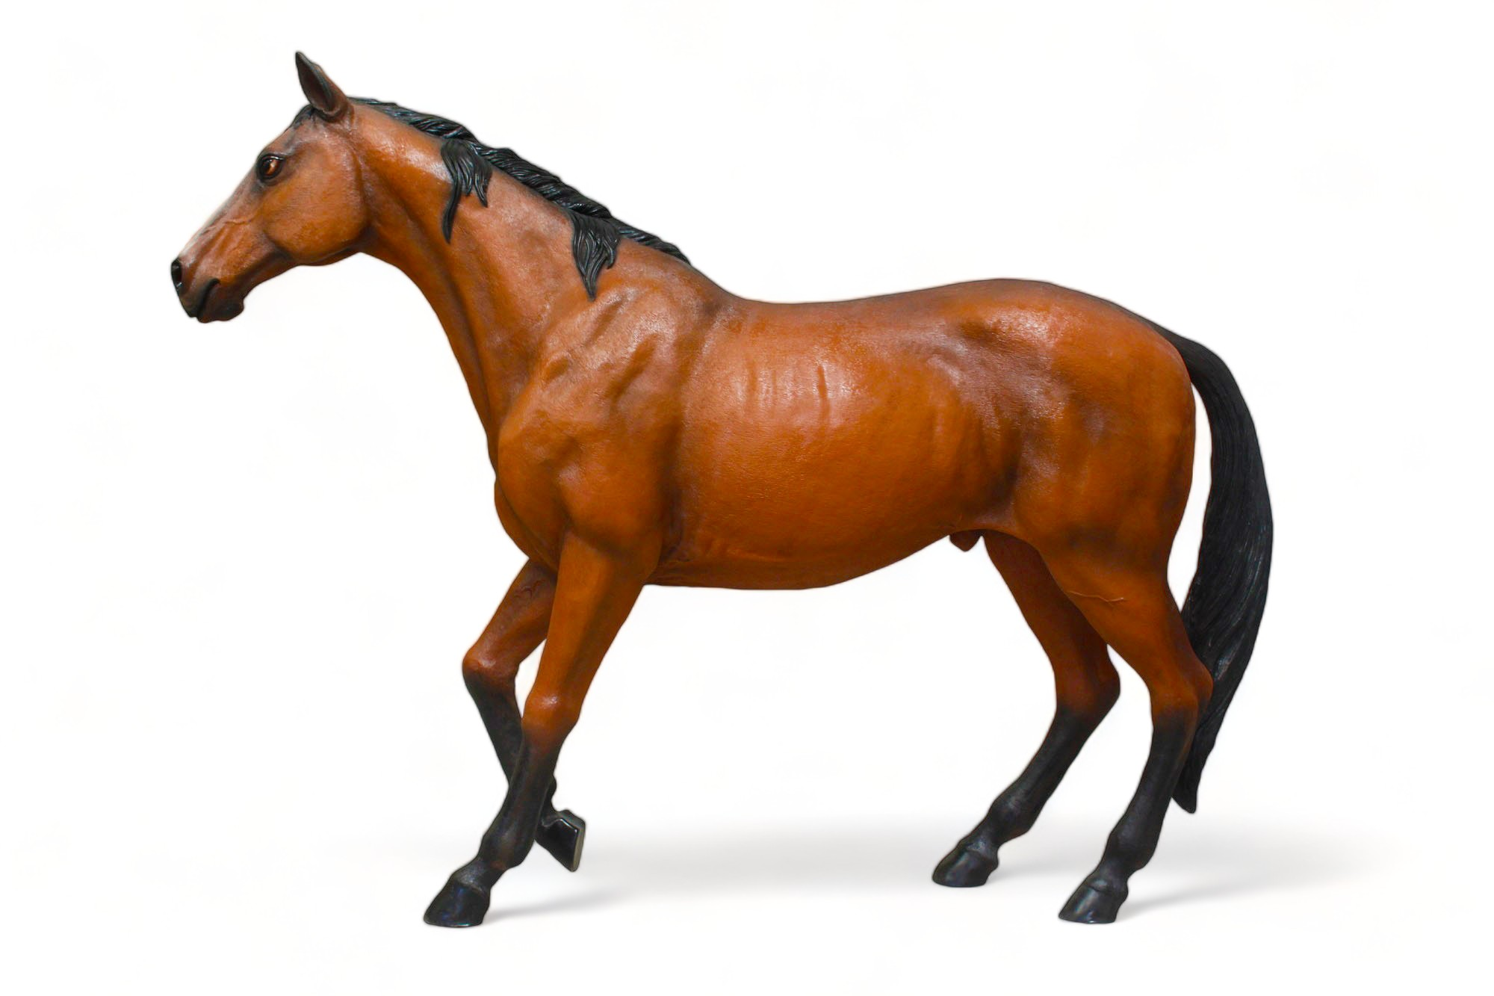
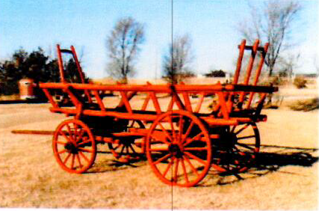
Items already procured for the Project

Slide 7
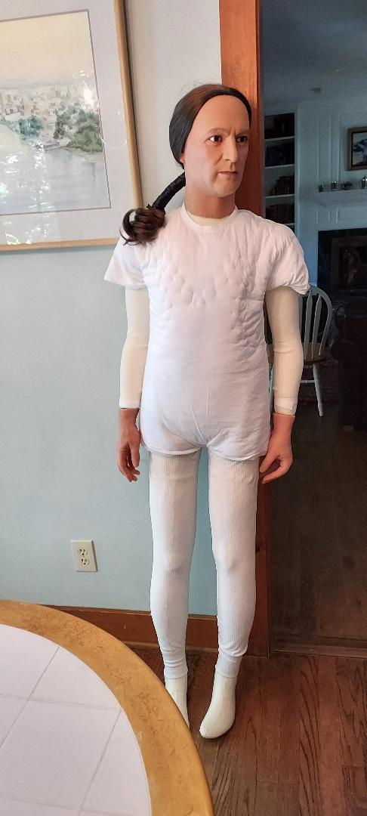
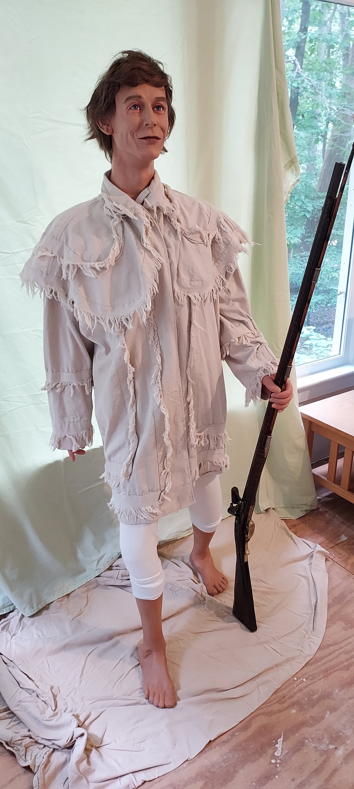
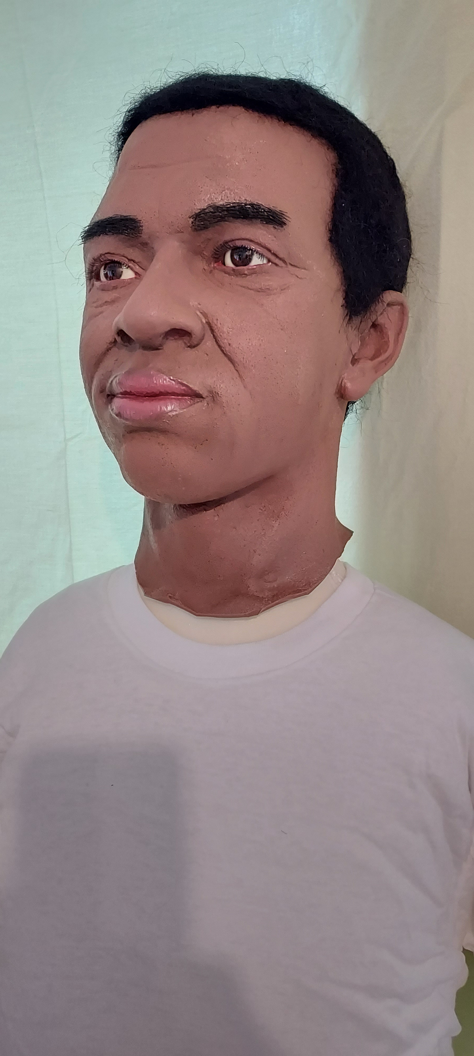
Additional Mannequin Samples ~ NC Brigade Project

Slide 8
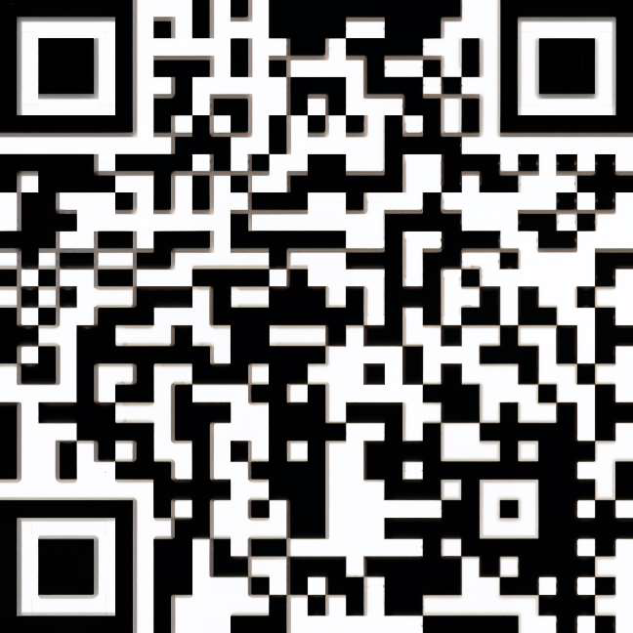
What is needed to complete NC Brigade Project?
Donations can be by check
  Payable to;
  Raleigh Chapter SAR
  Send to:
  Raleigh Chapter SAR
  c/o Robert Sigmon
  1104 Carrington Drive
  Raleigh, NC 27615
Via PayPal:
RaleighChapterSAR@gmail.com
~ OR ~
Raleigh Chapter SAR is a charitable, educational, 501c3 nonprofit with IRS EIN 56-6075402

